Slide 1
Camera Calibration & Road objects detection and segmentation
By- Devyash Parihar ID No: 2016A7PS0066P
PS-II station - MapmyIndia, Bengaluru

Slide 2

Know-Your-Organization
MapmyIndia, Bengaluru
1992
CE Info Systems Pvt Ltd
‹#›

Slide 3
Problem Definition/Objective
To get the intrinsic and extrinsic parameters of camera.
To train a convolutional network to detect and segment road objects.

Slide 4
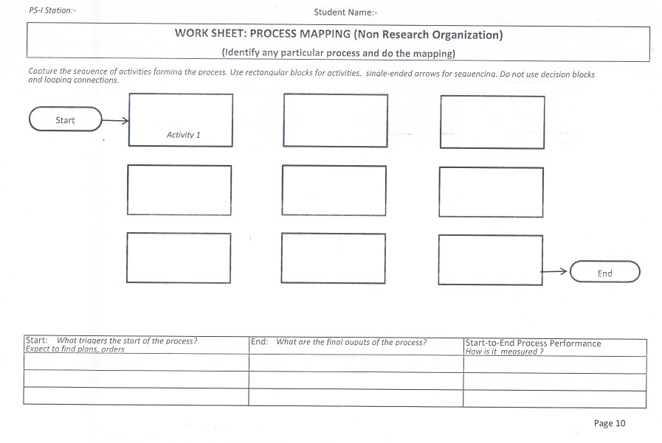
Process Mapping
survey-----------> processing-
----->deployment
‹#›

Slide 5
Background and Significance
In computer vision, geometry describes the structure and shape of the world.It concerns measures such as depth, volume, shape, pose,disparity, motion or optical flow.
Simple geometry can be used to study the formation of images by projection through a camera, simple mathematical rules to study the relation between a point in the world and the same point as seen in an image.

Slide 6
Background and Significance
Both object detection and semantic segmentation of camera images are important tasks for automated vehicles.
Object detection is necessary so that the planning and behavior modules can reason about other road users.
Semantic segmentation provides for example free space information and information about static and dynamic parts of the environment.

Slide 7
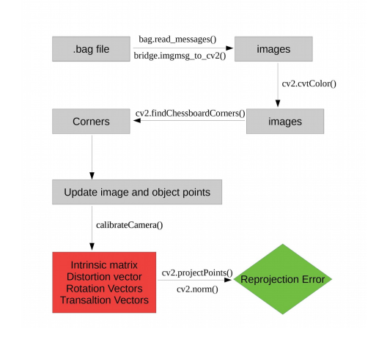
Methodology - Intrinsic
Flowchart for calculation of intrinsic parameters

Slide 8
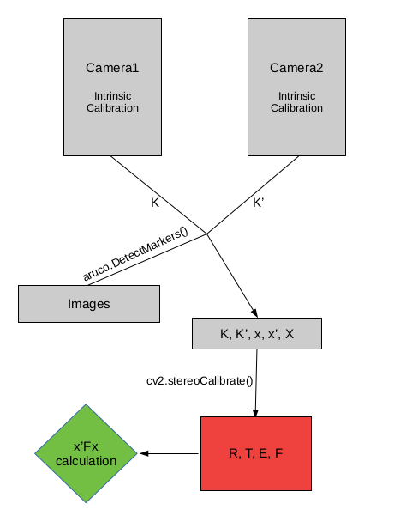
Methodology - Extrinsic
Flowchart for calculation of extrinsic parameters

Slide 9
Methodology - Mask R-CNN
Mask R-CNN does image segmentation by adding a branch to Faster R-CNN that outputs a binary mask that says whether or not a given pixel is part of an object.
Inputs: CNN Feature Map.
Outputs: Matrix with 1s on all locations where the pixel belongs to the object and 0s elsewhere

Slide 10
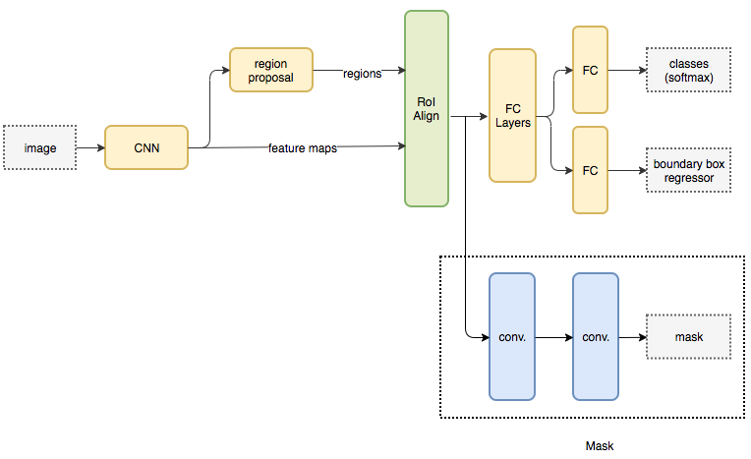
Methodology - Mask R-CNN
Architecture for Mask R-CNN

Slide 11
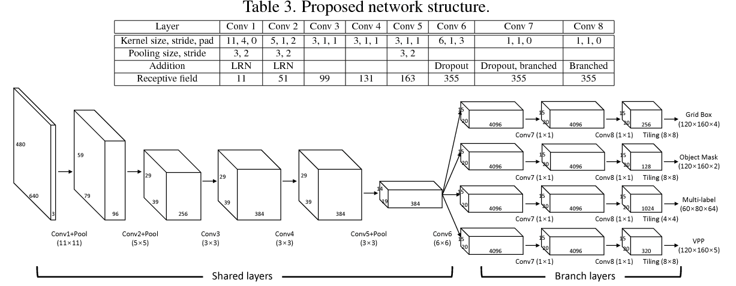
Methodology - VPGNet
Architecture for Vanishing Point Guided Network for Lane and Road Marking Detection and Recognition (VPGNet)

Slide 12
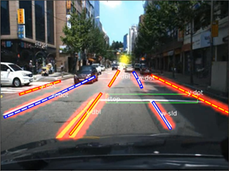
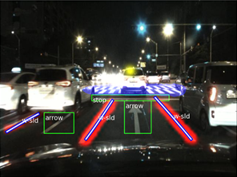
Methodology - VPGNet
Sample annotations for vanishing point

Slide 13
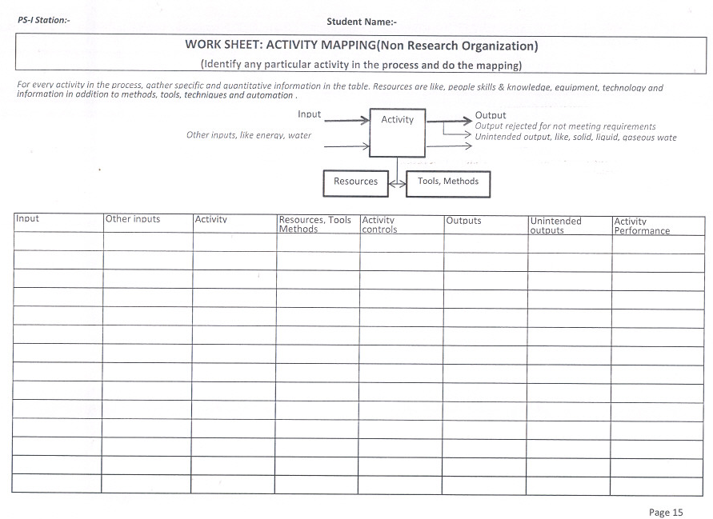
Activity Mapping
‹#›

Slide 14
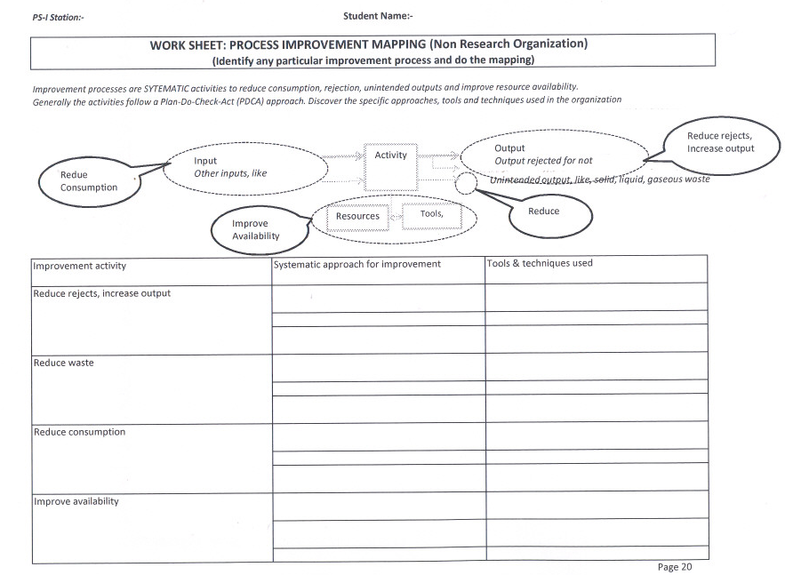
Process Improvement Mapping
‹#›

Slide 15
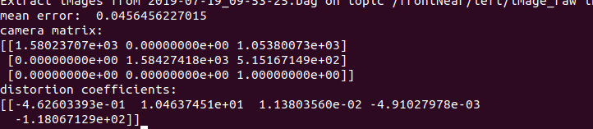
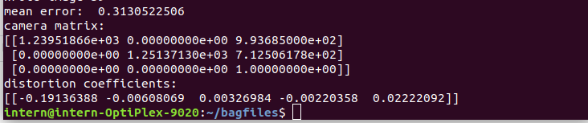
Results - Camera Calibration
Simply selecting first 40 images:
Skipping a few images after each image:

Slide 16
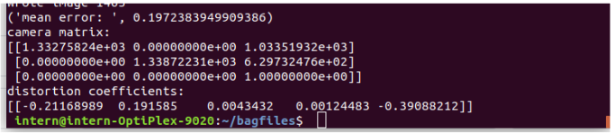
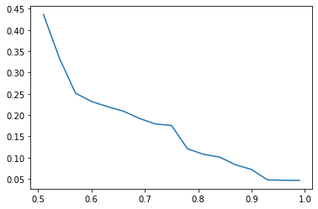
Results - Camera Calibration
Using Structural Similarity index and filtering (SSIM = 0.65):
A plot of threshold value of ssim of selected images(X) against the reprojection error(Y)

Slide 17
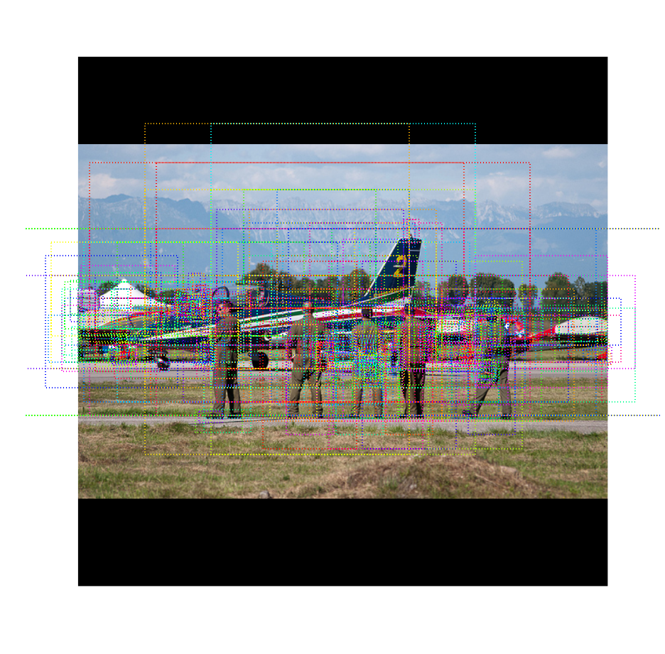
Results - Mask R-CNN
Anchor sorting and filtering

Slide 18
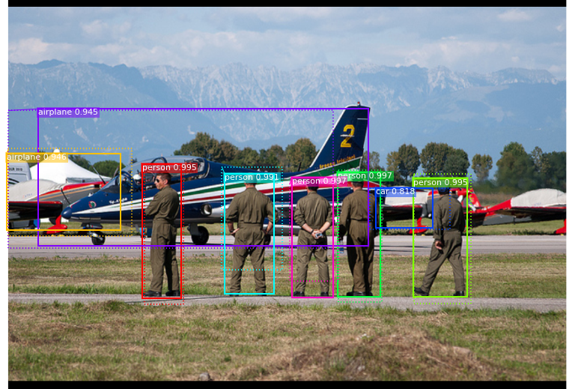
Results - Mask-R CNN
Bounding box refinement

Slide 19
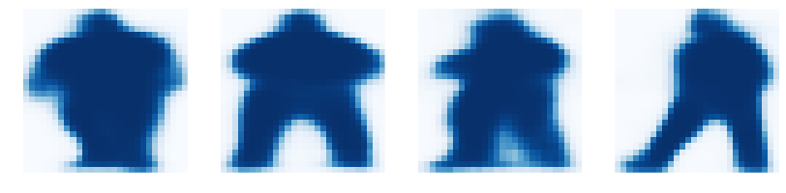
Results - Mask-R CNN
Mask generation

Slide 20
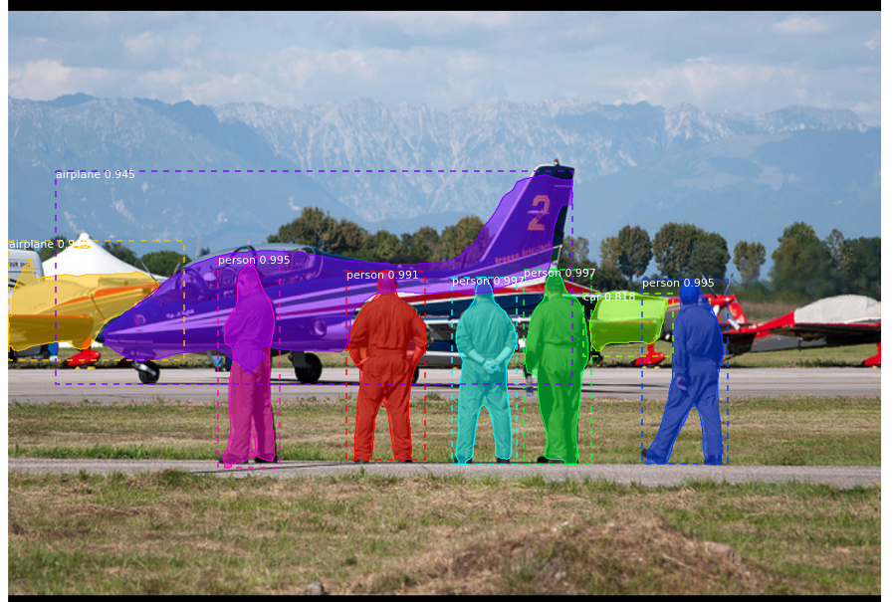
Results - Mask-R CNN
Final result

Slide 21
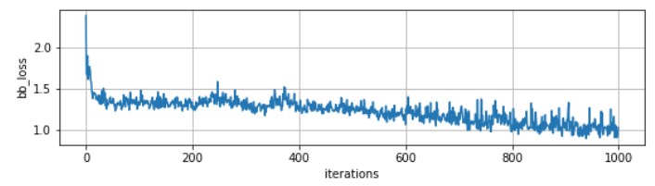
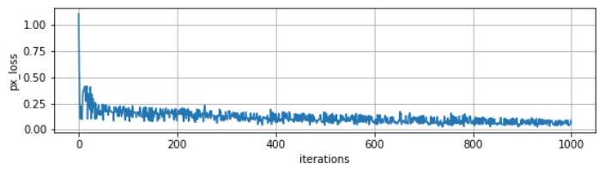
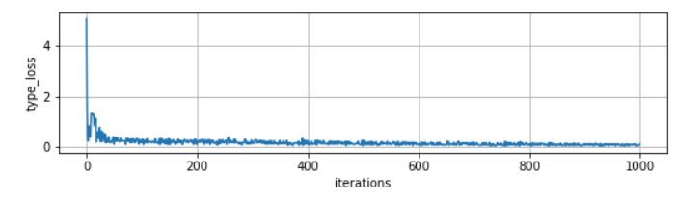
Results - VPGNet
bounding
box loss
objects
mask
loss
multi label
loss

Slide 22
Current status of project and post mid sem plan
Currently I am working on VPGNet and have successfully trained the model using Caltech Lanes dataset.
I (with the help of the constant feedback from Navada sir) am trying to write a script to test the trained model on our dataset to see how “good” it performs.

Slide 23
Summary and conclusion
The first key step for robust autonomous driving is to recognize and understand the environment around a subject.
However, simple recognition of obstacles and understanding of geometry around a vehicle is insufficient.
There are traffic regulations dictated by traffic symbols such as lane and road markings that should be complied with.
Moreover, for an algorithm to be applicable to autonomous driving, it should be robust under diverse environments and perform in real-time.

Slide 24
References
[1] S. Ren, K. He, R. Girshick, and J. Sun. Faster r-cnn: Towards real-time object detection with region proposal networks. In NIPS, 2015.
[2] A. Borji. Vanishing point detection with convolutional neural networks. arXiv preprint arXiv:1609.00967, 2016
[3] Seokju Lee, Namil Kim, and Jae Shin Yoon. Vanishing Point Guided Network for Lane and Road Marking Detection and Recognition. arXiv preprint arXiv:1710.06288, 2019
[4] Kaiming He, Georgia Gkioxari, Piotr Dollar, Ross Girshick. Mask R-CNN. arXiv preprint arXiv:1703.06870, 2018
[5] J. Redmon, S. Divvala, R. Girshick, and A. Farhadi. You only look once: Unified, real-time object detection. arXiv preprint arXiv:1506.02640, 2015
[6] J. Li, X. Mei, and D. Prokhorov. Deep neural network for structural prediction and lane detection in traffic scene. IEEE Transactions on Neural Networks and Learning Systems (TNNLS), PP(99):1–14, 2016

